Slide 1
Is Inequality Harmful for Growth?
Written by Torsten Persson, Guido Tabellini
National Bureau of Economic Research working paper No. 3599
January, 1991
Presenter: Zhijun Lu

Slide 2
The motivation
The literature on endogenous growth has clarified the importance of policy for growth.
The work on endogenous policy has shown the importance of distribution for policy.
Can we draw a direct link between distribution(inequality) and growth?
Opposite approach relative to the one of economic development literature (Kuznets curve).
Alensia and Rodrik (1993) study the determination of tax policy in the political equilibrium of an endogenous-growth model, finding a negative empirical link between inequality and growth.

Slide 3
The idea of this paper
Economic growth is determined by accumulation of productive factors.
The incentives to accumulate depend on tax policies and regulation
We expect a society with more inequality to implement policies that allow less taxation on investment, which lead to less accumulation, and result in less growth.

Slide 4
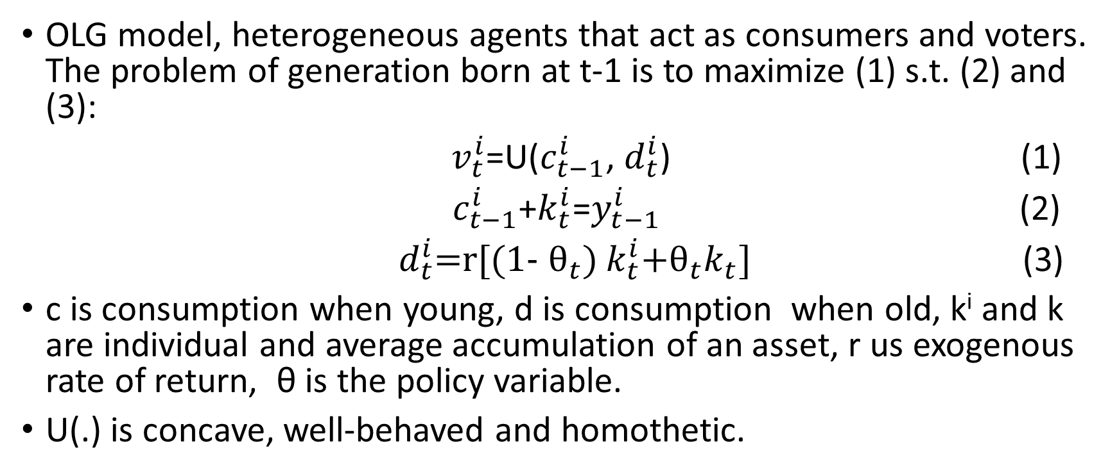
The model
OLG model, heterogeneous agents that act as consumers and voters. The problem of generation born at t-1 is to maximize (1) s.t. (2) and (3):
$v_{t}^{i}$=U($c_{t−1}^{i}$, $d_{t}^{i}$) (1)
$c_{t−1}^{i}$+$k_{t}^{i}$=$y_{t−1}^{i}$ (2)
$d_{t}^{i}$=r[(1- ${\text{θ}}_{t}$) $k_{t}^{i}$+${\text{θ}}_{t}k_{t}$] (3)
c is consumption when young, d is consumption when old, k^{i} and k are individual and average accumulation of an asset, r us exogenous rate of return, θ is the policy variable.
U(.) is concave, well-behaved and homothetic.

Slide 5
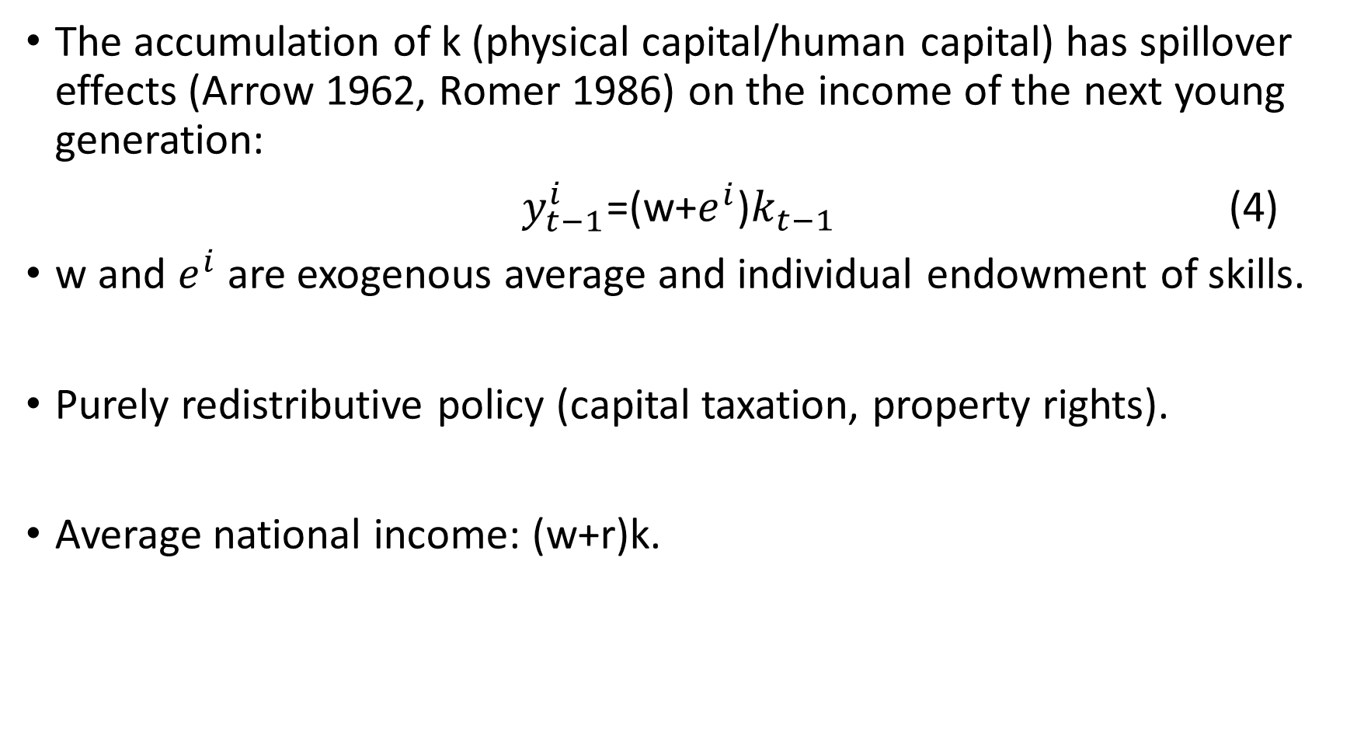
The accumulation of k (physical capital/human capital) has spillover effects (Arrow 1962, Romer 1986) on the income of the next young generation:
$y_{t−1}^{i}$=(w+$e^{i}$)$k_{t−1}$ (4)
w and $e^{i}$ are exogenous average and individual endowment of skills.
Purely redistributive policy (capital taxation, property rights).
Average national income: (w+r)k.

Slide 6
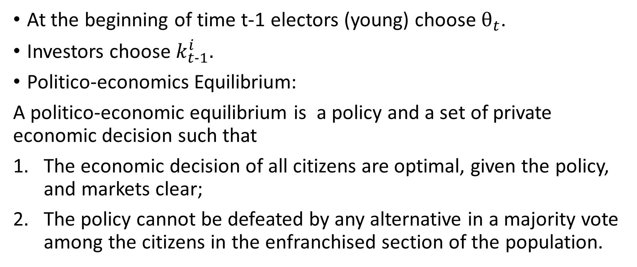
Time and Definition of Equilibrium
At the beginning of time t-1 electors (young) choose $θ_{t}$.
Investors choose $k_{t−1}^{i}.$
Politico-economics Equilibrium:
A politico-economic equilibrium is a policy and a set of private economic decision such that
The economic decision of all citizens are optimal, given the policy, and markets clear;
The policy cannot be defeated by any alternative in a majority vote among the citizens in the enfranchised section of the population.

Slide 7
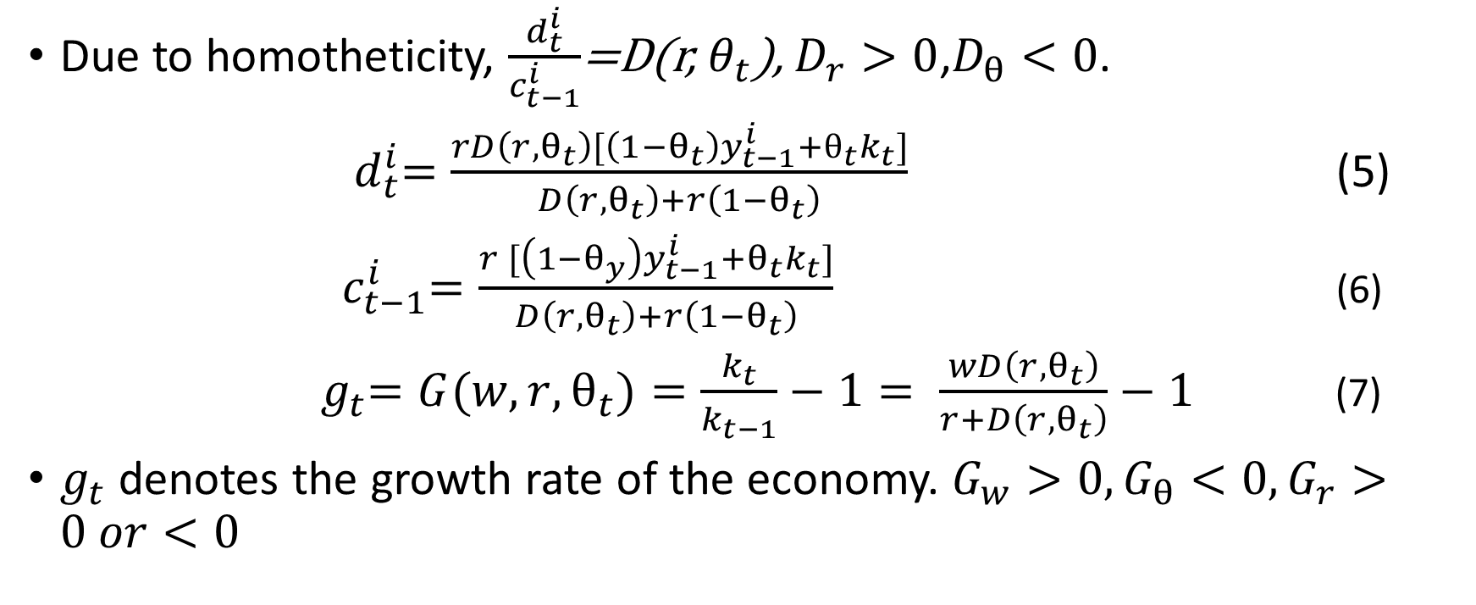
Characterization of Economic Equilibrium
Due to homotheticity, $\frac{d_{t}^{i}}{c_{t−1}^{i}}$=D(r, $θ_{t}$), $D_{r}>0$,$D_{θ}<0$.
${ d}_{t}^{i}=\frac{rD\left(r, θ_{t}\right)[\left(1−θ_{t}\right)y_{t−1}^{i}+θ_{t}k_{t}]}{D\left(r, θ_{t}\right)+r\left(1−θ_{t}\right)}$ (5)
${ c}_{t−1}^{i}=\frac{r [\left(1−θ_{y}\right)y_{t−1}^{i}+θ_{t}k_{t}]}{D\left(r, θ_{t}\right)+r\left(1−θ_{t}\right)}$ (6)
${ g}_{t}=G(w,r,θ_{t})=\frac{k_{t}}{k_{t−1}}−1= \frac{wD\left(r, θ_{t}\right)}{r+D\left(r, θ_{t}\right)}−1$ (7)
$g_{t}$ denotes the growth rate of the economy. $G_{w}>0, G_{θ}<0, G_{r}>0 or<0$

Slide 8
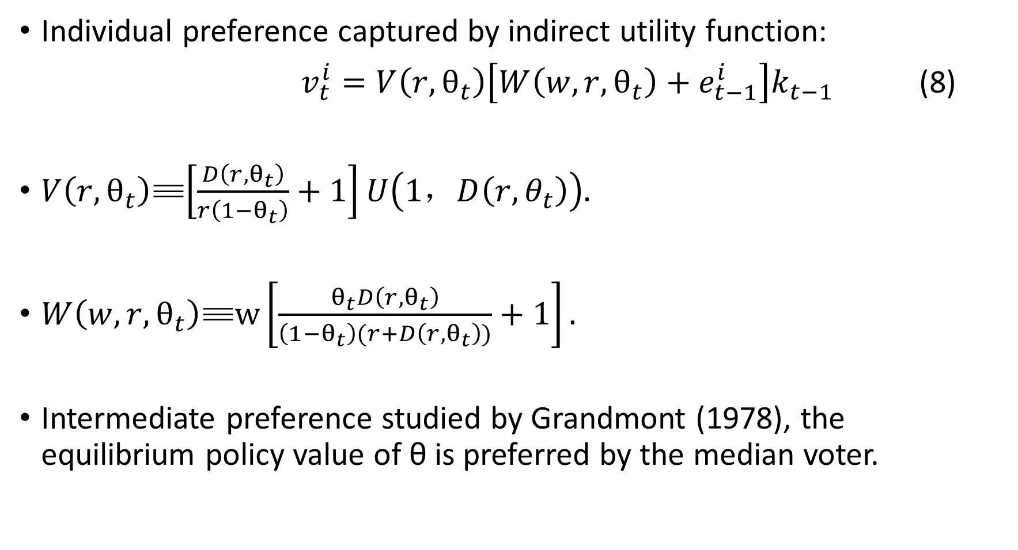
Characterization of Political Equilibrium
Individual preference captured by indirect utility function:
$v_{t}^{i}=V\left(r,θ_{t}\right)\left[W\left(w,r,θ_{t}\right)+e_{t−1}^{i}\right]k_{t−1}$ (8)
$V\left(r,θ_{t}\right)$≡$\left[\frac{D\left(r, θ_{t}\right)}{r\left(1−θ_{t}\right)}+1\right]U\left(1，D\left(r, θ_{t}\right)\right).$
$W\left(w,r,θ_{t}\right)$≡$w\left[\frac{θ_{t}D\left(r, θ_{t}\right)}{\left(1−θ_{t}\right)(r+D\left(r, θ_{t}\right))}+1\right].$
Intermediate preference studied by Grandmont (1978), the equilibrium policy value of θ is preferred by the median voter.

Slide 9
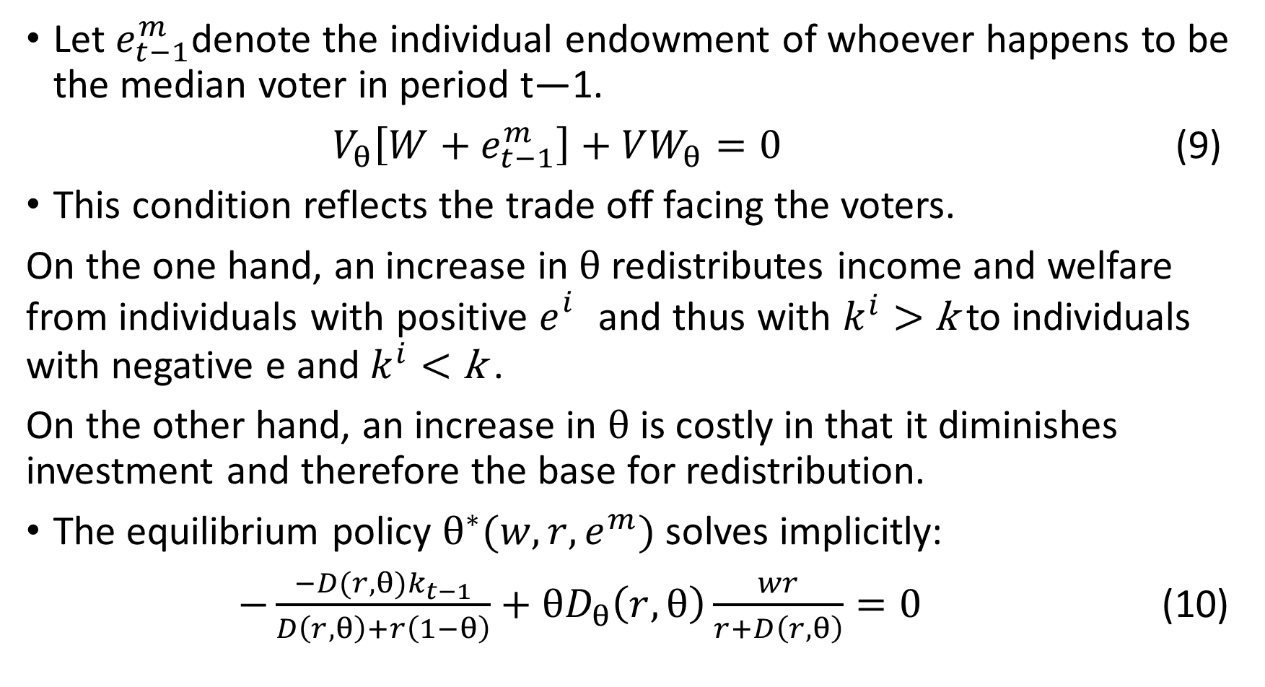
Let $e_{t−1}^{m}$denote the individual endowment of whoever happens to be the median voter in period t—1.
$V_{θ}\left[W+e_{t−1}^{m}\right]+VW_{θ}=0$ (9)
This condition reflects the trade off facing the voters.
On the one hand, an increase in $θ$redistributes income and welfare from individuals with positive $e_{}^{i}$ and thus with $k^{i}>$ k to individuals with negative e and $k^{i}<$ k .
On the other hand, an increase in $θ$ is costly in that it diminishes investment and therefore the base for redistribution.
The equilibrium policy $θ^{∗}(w,r,e^{m})$ solves implicitly:
$−\frac{−D(r,θ)k_{t−1}}{D\left(r,θ\right)+r\left(1−θ\right)}+θD_{θ}\left(r,θ\right)\frac{wr}{r+D\left(r,θ\right)}=0$ (10)

Slide 10
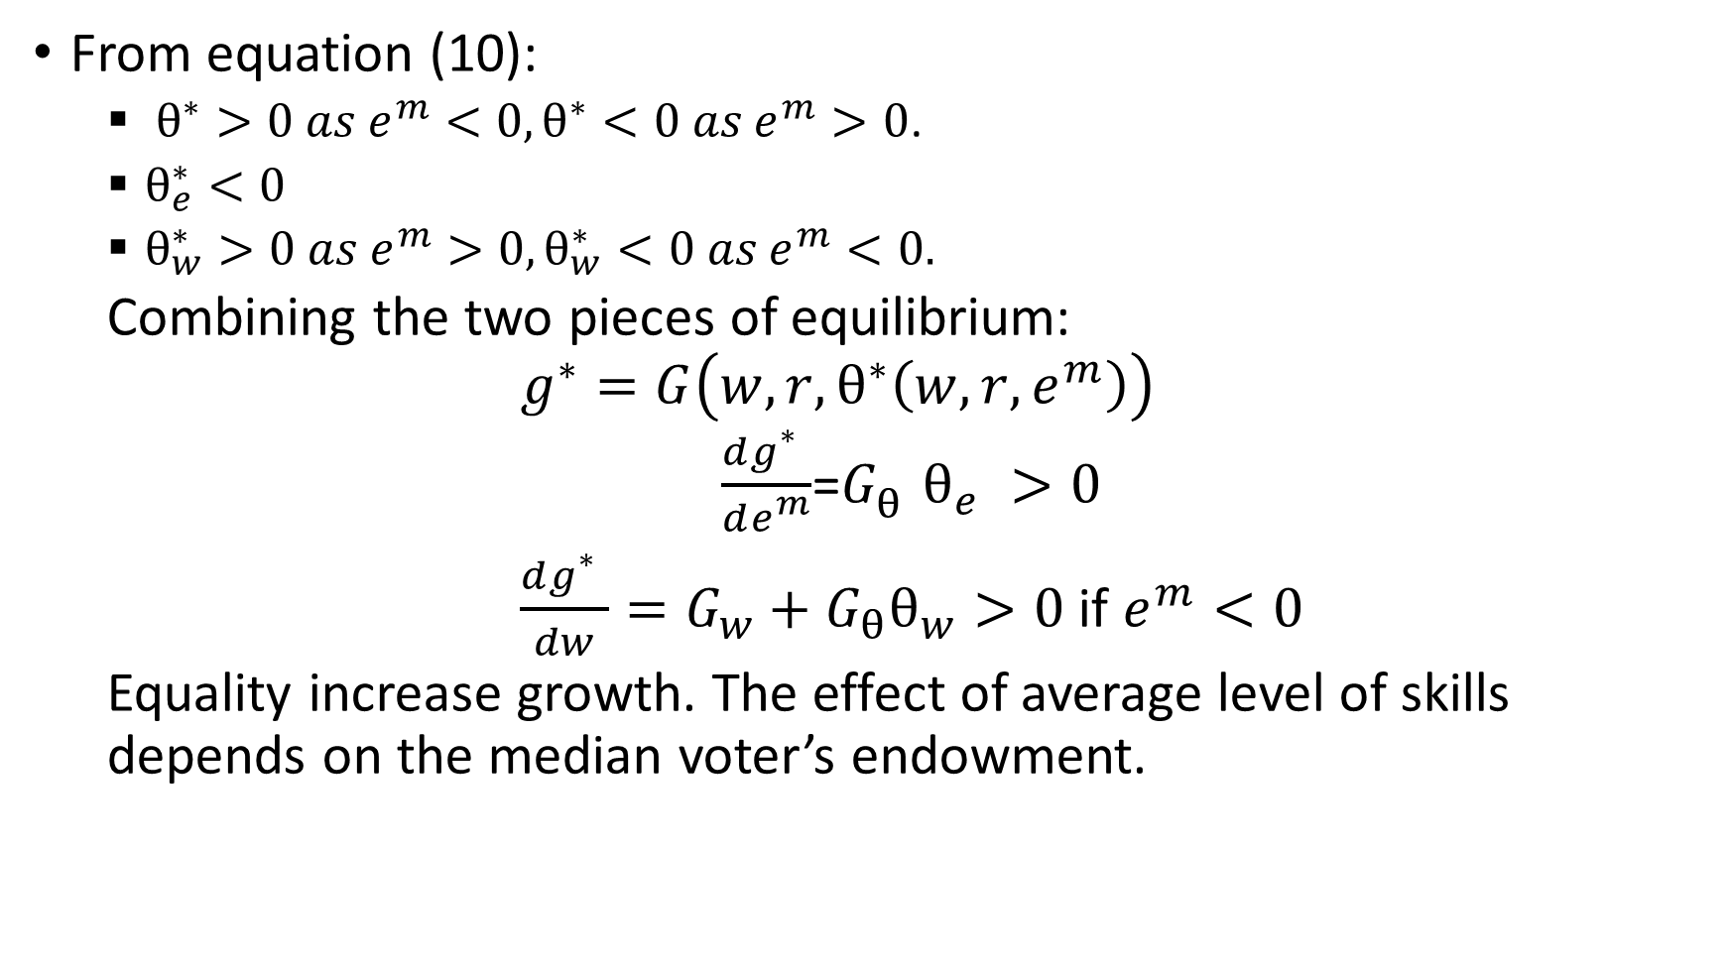
From equation (10):
$θ^{∗}>0 as e^{m}<0,θ^{∗}<0 as e^{m}>0$.
$θ_{e}^{∗}<0$
$θ_{w}^{∗}>0 as{ e}^{m}>0,θ_{w}^{∗}<0 as{ e}^{m}<0.$
Combining the two pieces of equilibrium:
$$g^{∗}=G\left(w,r, θ^{∗}\left(w,r,e^{m}\right)\right)$$
$\frac{dg_{}^{∗}}{de_{}^{m}}$=$G_{θ}^{}θ_{e}^{}>0$
$\frac{dg_{}^{∗}}{dw}=G_{w}+G_{θ}θ_{w}>0$ if $e^{m}<0$
Equality increase growth. The effect of average level of skills depends on the median voter’s endowment.

Slide 11
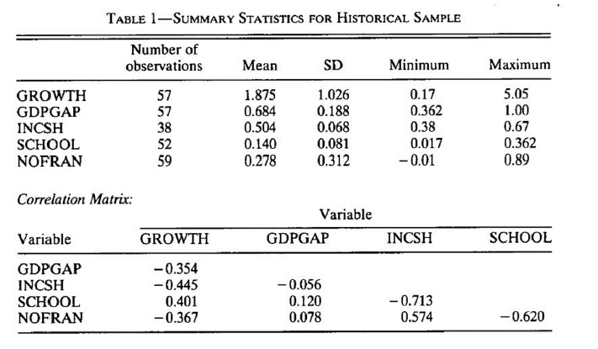
Historical Data(Raw data)

Slide 12
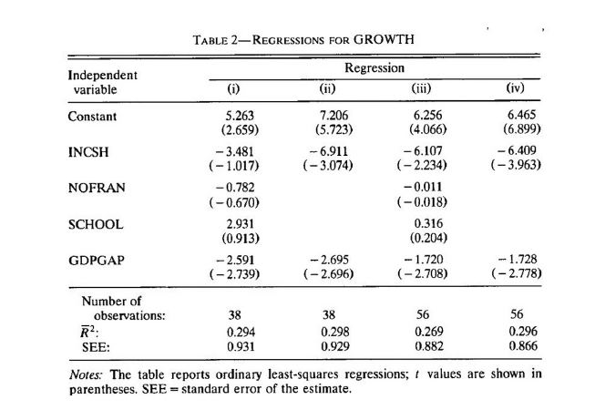
Historical Evidence(Regression Results)

Slide 13
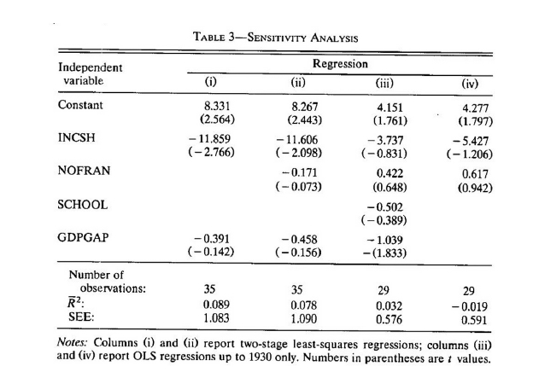
Historical Evidence(Sensitivity Analysis)

Slide 14
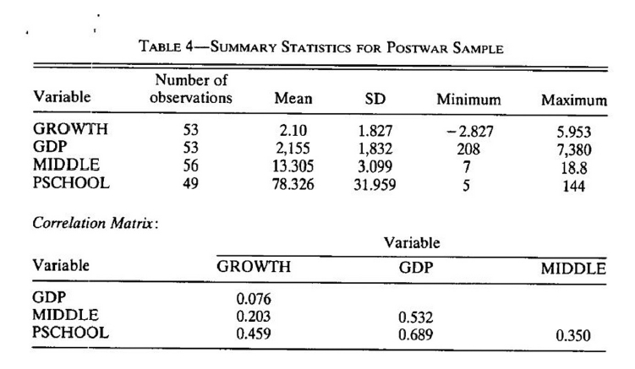
Postwar Data(Raw Data)

Slide 15
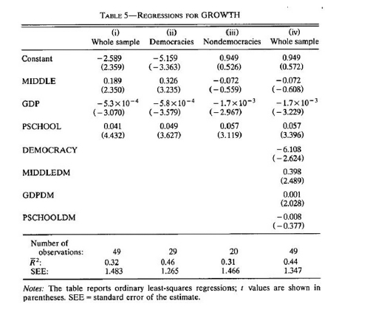
Postwar Evidence(Regression Results)

Slide 16
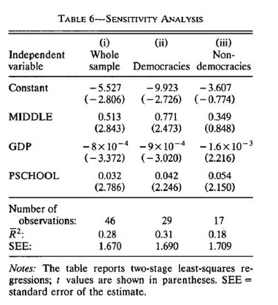
Postwar Evidence(Sensitivity Analysis)

Slide 17
Discussion of the Results
Empirical evidence statistically significant: higher inequality implies less growth, because it lead to policies that do not protect proper rights and do not allow full private appropriation of return from investment.
In the postwar database, this remains true for democracies.
Democracy should make a difference for the effect of income inequality on growth

Slide 18
Thanks!

